Slide 1
CIS 4930-001: Introduction to Augmented and Virtual Reality
The Business of Augmented & Virtual Reality

Slide 2
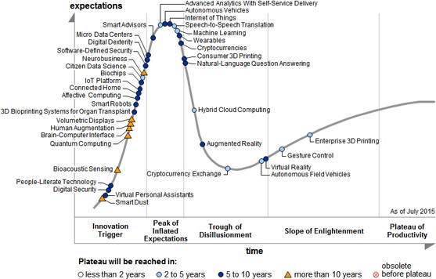
Gartner Hype Cycle (2015)

Slide 4
AR/VR Investments

Slide 6
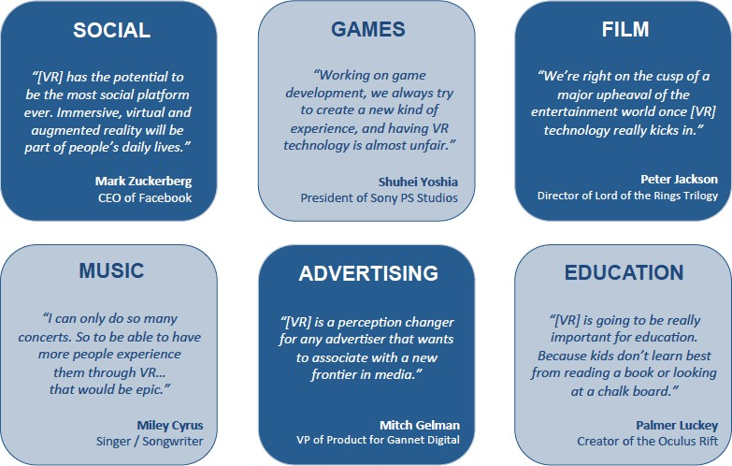
Potential for Disruption
From BDMI

Slide 7
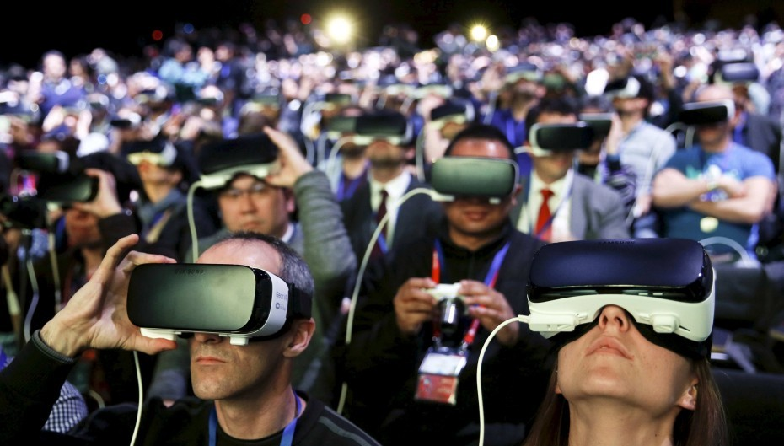
Mobile virtual reality on track to hit $861M in revenues in 2016
JEFFGRUBB FEBRUARY 25, 2016 8:00 AM
TAGS: AUGMENTED REALIT, Y GB FEATURED, GOOGLE, GOOGLECARDBOAR,D OCULUSVR, SAMSUN,G SAMSUNG GEARVR, VIRTUAL REALITY

Slide 8
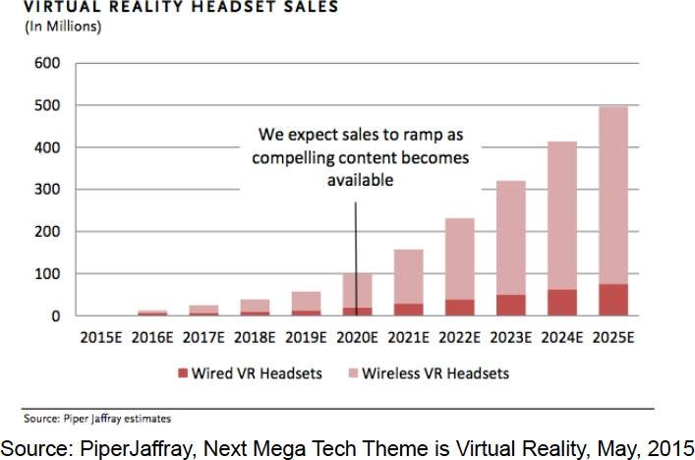
Projected HMD Sales

Slide 9
AR/VR Business 2020
VR—Tens of millions customers: Games, 3D Movies
AR—Hundreds of millions of customers: Mobile devices

Slide 10
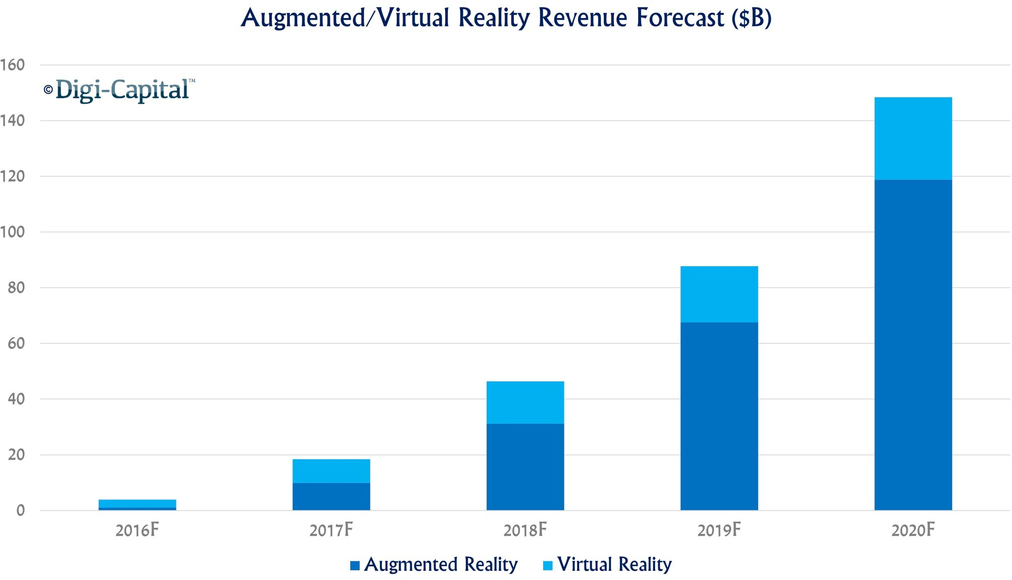
AR/VR Business 2020
AR/VR to hit $150 billion disrupting mobile by 2020
cf. 2014 computer game market = $84 Billion USD

Slide 11
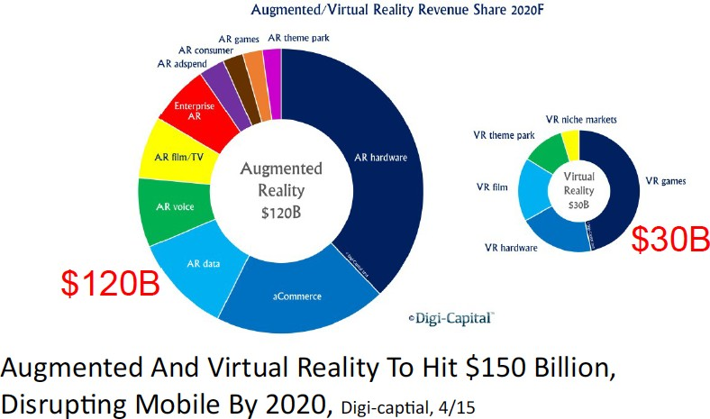
AR / VR Market Size
• sadf

Slide 12
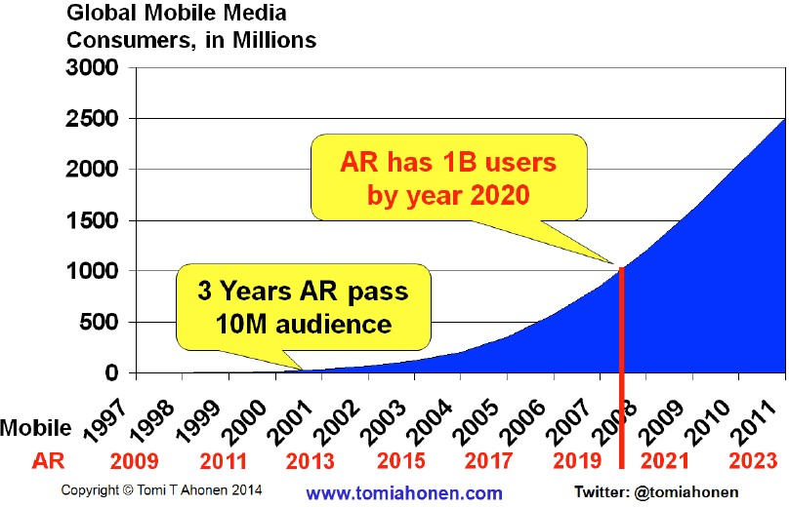
Forecast Number of Users

Slide 13
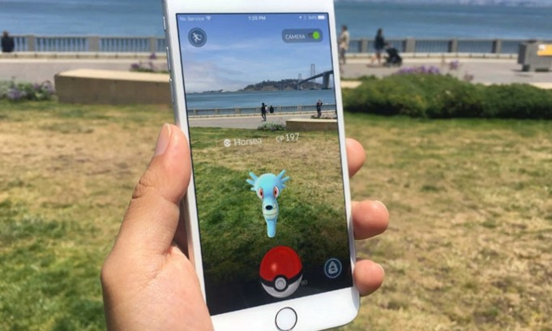
Pokemon GO
Killer Combo: brand + social + mobile + geo-location + AR

Slide 14
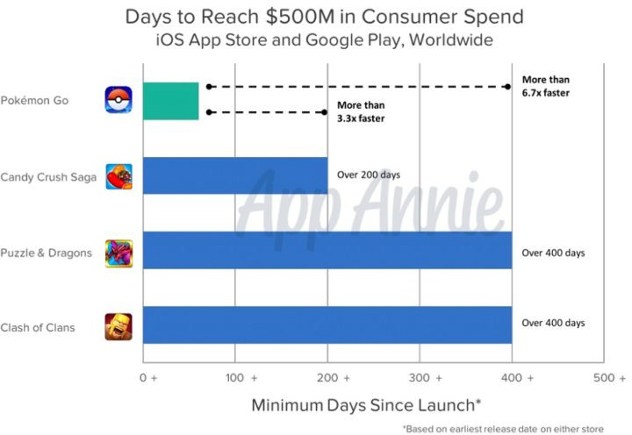
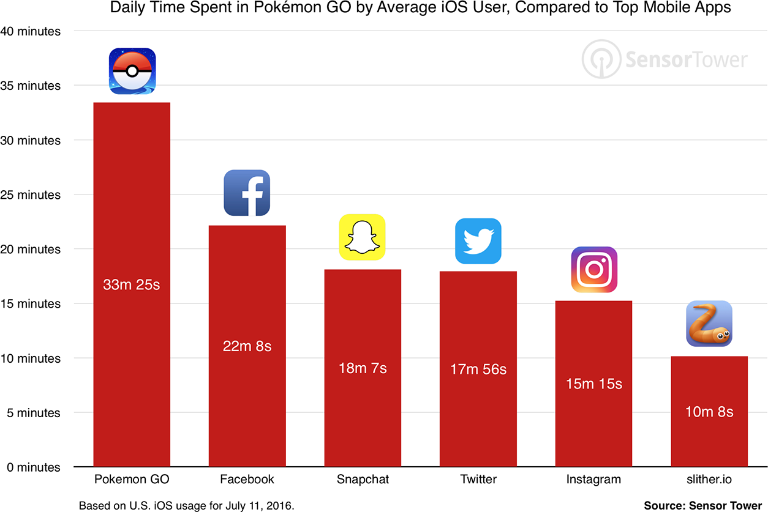
Pokemon GO Effect
Fastest App to reach $500 million in Revenue
Only 63 days after launch (> $1 Billion in 6 months)
Over 500 million downloads, > 25 million DAU
Nintendo stock price up by 50% (gain of $9 Billion USD)

Slide 15
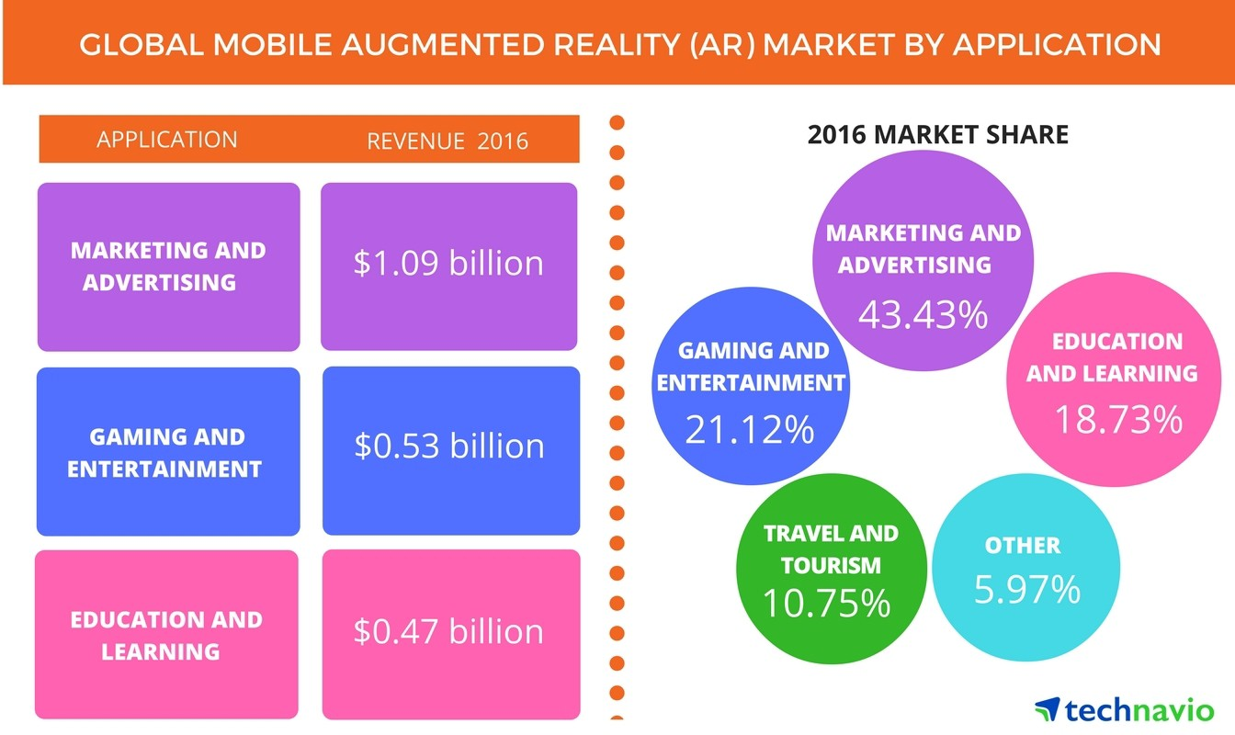

Slide 16
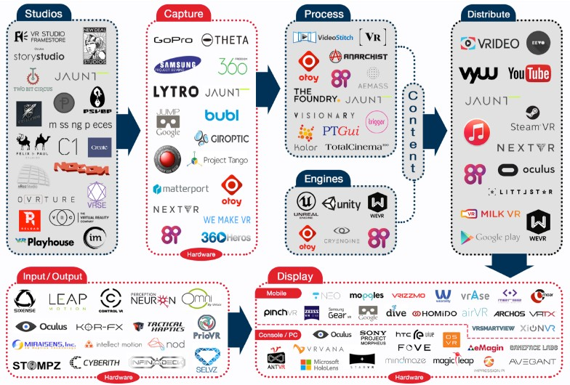
• sdas

Slide 19

Why today won’t be like mid-90’s
It’s not just VR anymore
Huge amount of investment
Inexpensive hardware platforms
Easy to use content creation tools
New devices for input and output
Proven use cases – not just Hype!

Slide 20
Lessons Learned
Don’t believe the hype
Not everything is better in VR
Many factors determine technology acceptance
Human Centered Design/Design for users
Need to move from Demo to Production
Profitable niche markets first
Follow the money

Slide 21
So, you want to work in the gaming industry? Watch this…
https://youtu.be/pLAi_cmly6Q

